Slide 1
Applied Cryptography Jacobi symbol, Euler pseudo-prime, Solovay-Strassen test
Liangfeng Zhang
School of Information Science and Technology
ShanghaiTech University

Slide 2

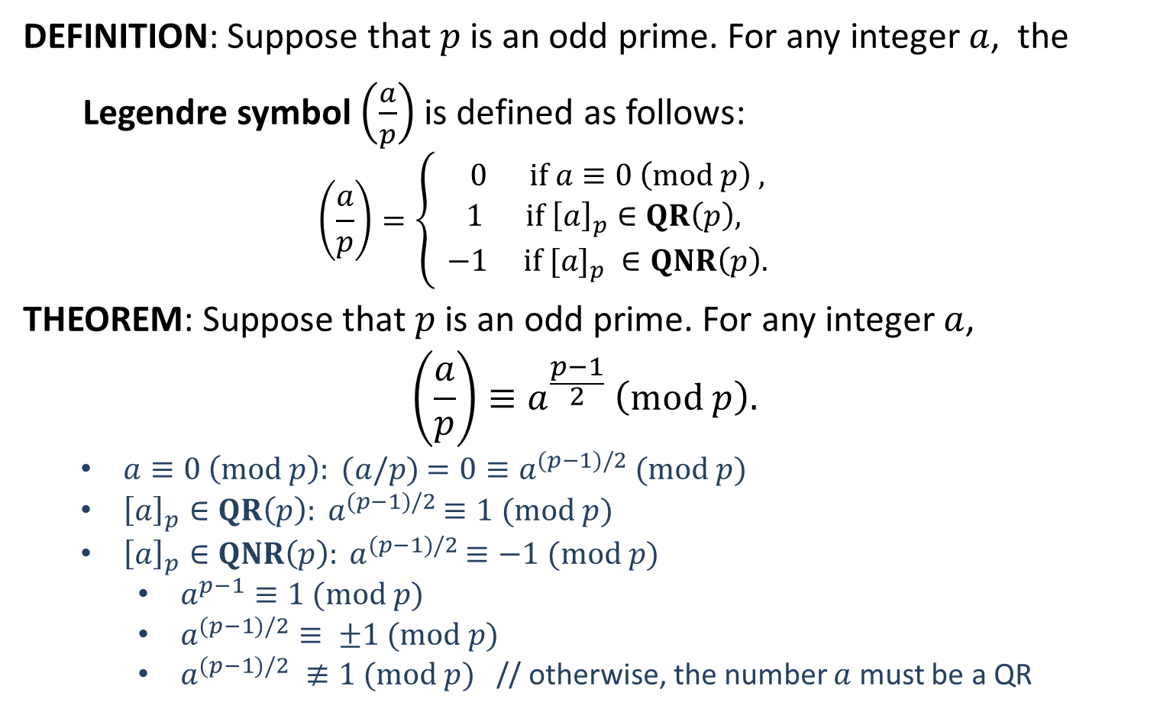
Legendre Symbol
DEFINITION: Suppose that $p$ is an odd prime. For any integer $a$, the
Legendre symbol $\left(\frac{a}{p}\right)$ is defined as follows:
$$\left(\frac{a}{p}\right)=\left\{\begin{aligned} 0 if a≡0 \left(mod p\right) , \\ 1 if {\left[a\right]}_{p}∈QR\left(p\right), \\ −1 if [a]_{p} ∈QNR\left(p\right). \end{aligned}\right.$$
THEOREM: Suppose that $p$ is an odd prime. For any integer $a$,
$$\left(\frac{a}{p}\right)≡a^{\frac{p−1}{2}} \left(mod p\right).$$
$a≡0 \left(mod p\right): (a/p)$ $=0≡a^{(p−1)/2}$ $(mod p)$
${\left[a\right]}_{p}∈QR\left(p\right): a^{(p−1)/2}$ $≡1$ $(mod p)$
${\left[a\right]}_{p}∈QNR\left(p\right): a^{(p−1)/2}$ $≡−1$ $(mod p)$
$a^{p−1}≡1 (mod p)$
$a^{(p−1)/2}≡ ±1 (mod p)$
$a^{(p−1)/2} ≢1 (mod p)$ // otherwise, the number $a$ must be a QR
$$\left(\frac{−1}{p}\right)={\left(−1\right)}^{\frac{p−1}{2}}$$

Slide 3

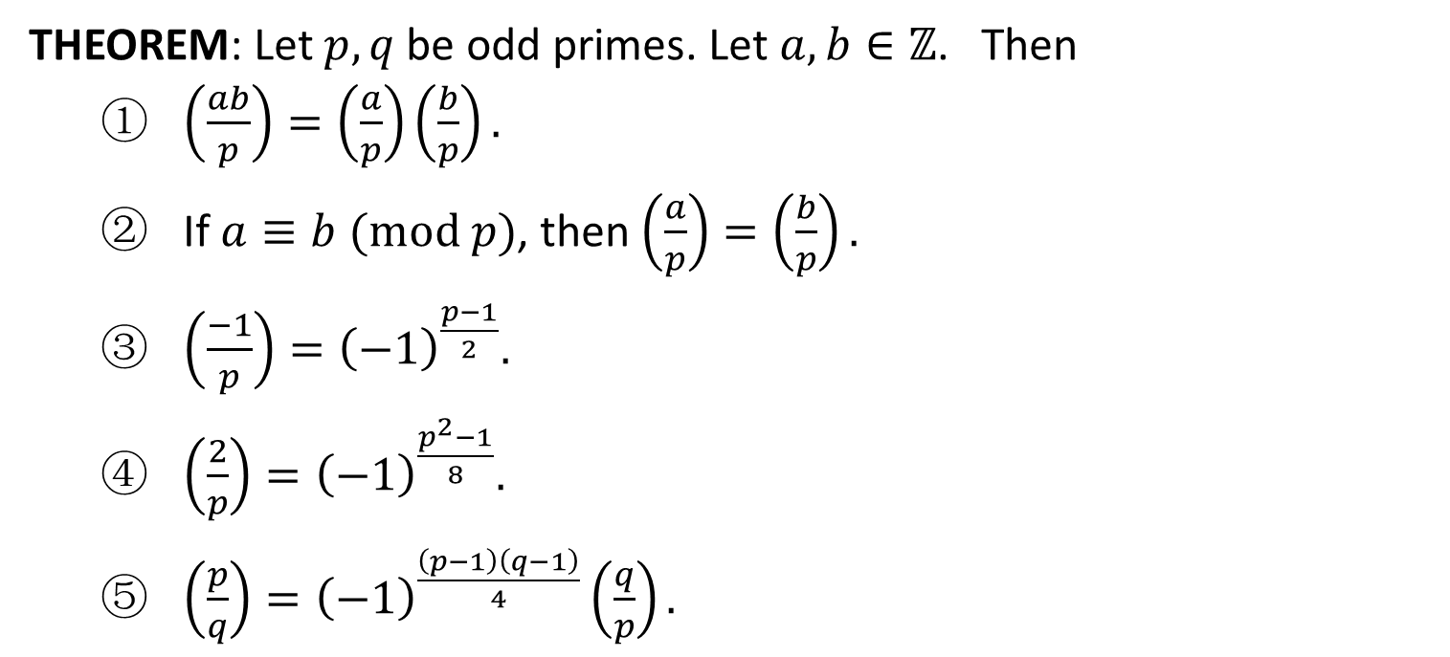
Legendre Symbol
THEOREM: Let $p,q$ be odd primes. Let $a,b∈ℤ$. Then
$\left(\frac{ab}{p}\right)=\left(\frac{a}{p}\right)\left(\frac{b}{p}\right).$
If $a≡b (mod p)$, then$\left(\frac{a}{p}\right)=\left(\frac{b}{p}\right).$
$\left(\frac{−1}{p}\right)={\left(−1\right)}^{\frac{p−1}{2}}.$
$\left(\frac{2}{p}\right)={\left(−1\right)}^{\frac{p^{2}−1}{8}}.$
$\left(\frac{p}{q}\right)={\left(−1\right)}^{\frac{\left(p−1\right)\left(q−1\right)}{4}}\left(\frac{q}{p}\right).$
$$\left(\frac{11}{13}\right)=\left(\frac{13}{11}\right){\left(−1\right)}^{30}$$
$=\left(\frac{2}{11}\right)$
$={\left(−1\right)}^{({11}^{2}−1)/8}$
$={\left(−1\right)}^{15}$
$=−1$

Slide 5
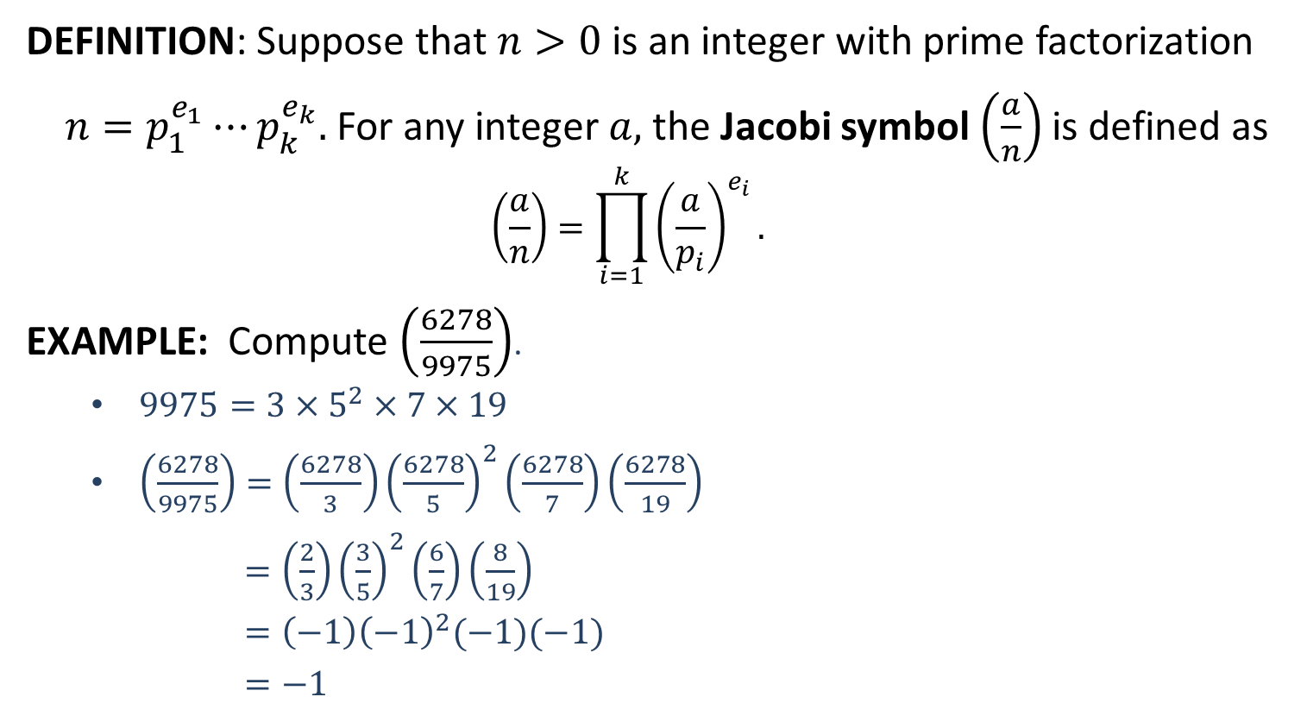
Jacobi Symbol
DEFINITION: Suppose that $n>0$ is an integer with prime factorization
$n=p_{1}^{e_{1}}⋯p_{k}^{e_{k}}.$ For any integer $a,$ the Jacobi symbol $\left(\frac{a}{n}\right)$ is defined as
$$\left(\frac{a}{n}\right)=\prod_{i=1}^{k}{{\left(\frac{a}{p_{i}}\right)}^{e_{i}}}.$$
EXAMPLE: Compute $\left(\frac{6278}{9975}\right)$.
$9975=3×5^{2}×7×19$
$\left(\frac{6278}{9975}\right)=\left(\frac{6278}{3}\right){\left(\frac{6278}{5}\right)}^{2}\left(\frac{6278}{7}\right)\left(\frac{6278}{19}\right)$
$=\left(\frac{2}{3}\right){\left(\frac{3}{5}\right)}^{2}\left(\frac{6}{7}\right)\left(\frac{8}{19}\right)$
$=\left(−1\right){\left(−1\right)}^{2}(−1)(−1)$
$=−1$

Slide 6


Jacobi Symbol
THEOREM: Let $m,n>0$ be odd integers and let $a,b∈ℤ$. Then
$\left(\frac{ab}{n}\right)=\left(\frac{a}{n}\right)\left(\frac{b}{n}\right).$
$\left(\frac{a}{mn}\right)=\left(\frac{a}{m}\right)\left(\frac{a}{n}\right).$
If $a≡b (mod n)$, then $\left(\frac{a}{n}\right)=\left(\frac{b}{n}\right).$
$\left(\frac{−1}{n}\right)={\left(−1\right)}^{\frac{n−1}{2}} .$
$\left(\frac{2}{n}\right)={\left(−1\right)}^{\frac{n^{2}−1}{8}}.$
$\left(\frac{m}{n}\right)={\left(−1\right)}^{\frac{\left(m−1\right)\left(n−1\right)}{4}}\left(\frac{n}{m}\right).$
$\left(\frac{7411}{9283}\right)=−\left(\frac{9283}{7411}\right)$
$=−\left(\frac{1872}{7411}\right)$
$=−{\left(\frac{2}{7411}\right)}^{4}\left(\frac{117}{7411}\right)$
$=−\left(\frac{117}{7411}\right)$
$=−\left(\frac{7411}{117}\right)$
$=−\left(\frac{40}{117}\right)$
$=−{\left(\frac{2}{117}\right)}^{3}\left(\frac{5}{117}\right)$
$=\left(\frac{5}{117}\right)$
$=\left(\frac{117}{5}\right)$
$=\left(\frac{2}{5}\right)$
$=−1$

Slide 8
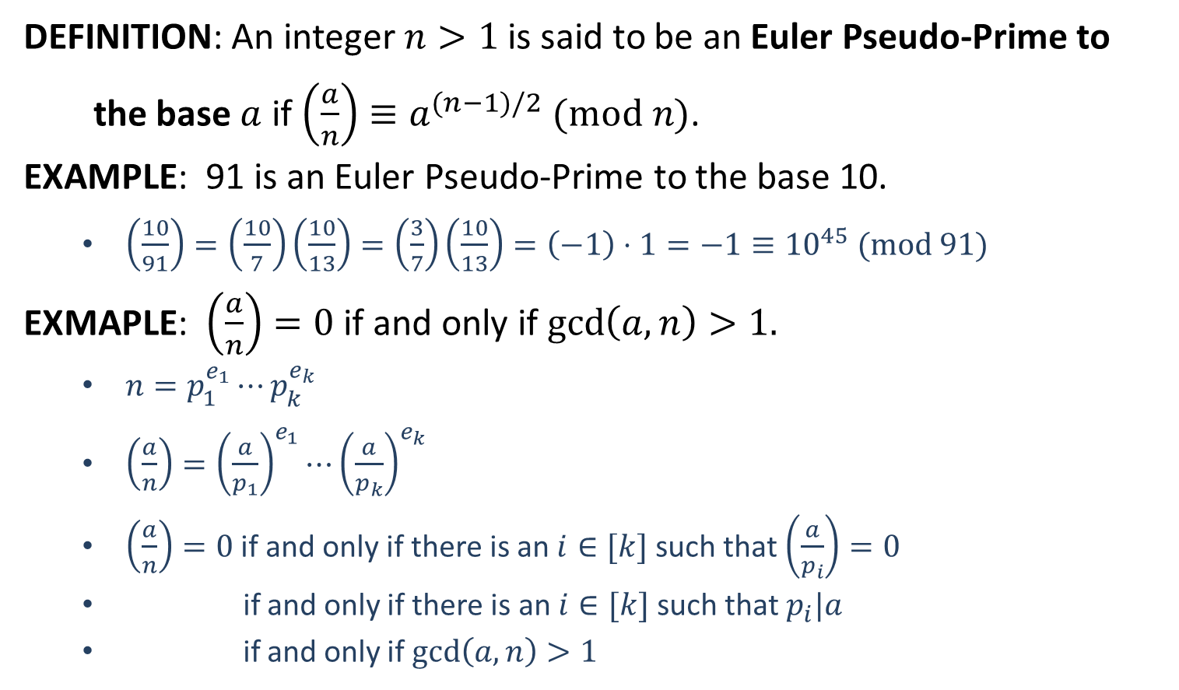
Euler Pseudo-Prime
DEFINITION: An integer $n>1$ is said to be an Euler Pseudo-Prime to
the base $a$ if $\left(\frac{a}{n}\right)≡a^{(n−1)/2}$ $(mod n)$.
EXAMPLE: 91 is an Euler Pseudo-Prime to the base 10.
$\left(\frac{10}{91}\right)=\left(\frac{10}{7}\right)\left(\frac{10}{13}\right)=\left(\frac{3}{7}\right)\left(\frac{10}{13}\right)=\left(−1\right)⋅1=−1≡{10}^{45} (mod 91)$
EXMAPLE: $\left(\frac{a}{n}\right)=0$ if and only if $\gcd\left(a,n\right)>1.$
$n=p_{1}^{e_{1}}⋯p_{k}^{e_{k}}$
$\left(\frac{a}{n}\right)={\left(\frac{a}{p_{1}}\right)}^{e_{1}}⋯{\left(\frac{a}{p_{k}}\right)}^{e_{k}}$
$\left(\frac{a}{n}\right)=0$ if and only if there is an $i∈[k]$ such that $\left(\frac{a}{p_{i}}\right)=0$
if and only if there is an $i∈[k]$ such that $p_{i}|a$
if and only if $\gcd\left(a,n\right)>1$

Slide 9
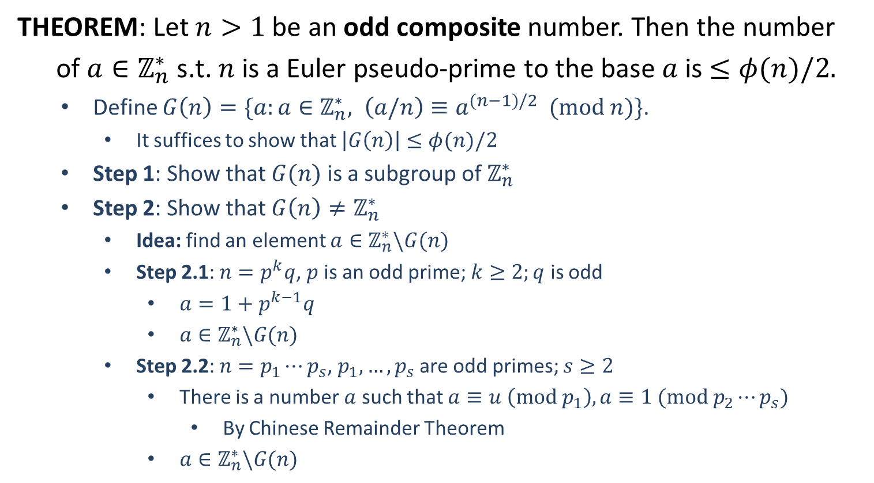
Euler Pseudo-Prime
THEOREM: Let $n>1$ be an odd composite number. Then the number
of $a∈ℤ_{n}^{∗}$ s.t. $n$ is a Euler pseudo-prime to the base $a$ is $≤φ(n)/2.$
Define $G\left(n\right)=\{a:a∈ℤ_{n}^{∗}, \left(a/n\right)≡a^{(n−1)/2} (mod n)\}$.
It suffices to show that $\left|G\left(n\right)\right|≤φ(n)/2$
Step 1: Show that $G(n)$ is a subgroup of $ℤ_{n}^{∗}$
Step 2: Show that $G\left(n\right)≠ℤ_{n}^{∗}$
Idea: find an element $a∈ℤ_{n}^{∗}\backslash G(n)$
Step 2.1: $n=p^{k}q$, $p$ is an odd prime; $k≥2;q$ is odd
$a=1+p^{k−1}q$
$a∈ℤ_{n}^{∗}\backslash G(n)$
Step 2.2: $n=p_{1}⋯p_{s}$, $p_{1},…,p_{s}$ are odd primes; $s≥2$
There is a number $a$ such that $a≡u \left(mod p_{1}\right), a≡1 (mod p_{2}⋯p_{s})$
By Chinese Remainder Theorem
$a∈ℤ_{n}^{∗}\backslash G(n)$

Slide 10
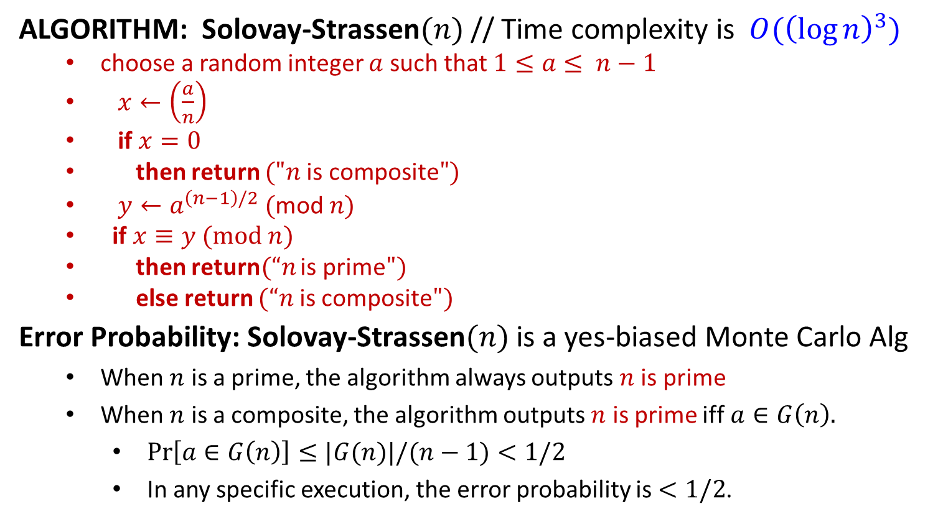
Solovay-Strassen Test
ALGORITHM: Solovay-Strassen$(n)$ // Time complexity is $O({\left(\log{n}\right)}^{3})$
choose a random integer $a$ such that $1≤a≤ n−1$
$x←\left(\frac{a}{n}\right)$
if $x=0$
then return $("n \text{is} \text{composite}")$
$y←a^{\left(n−1\right)/2} (\text{mod} n)$
if $x≡y (mod n)$
then return$(“n$ is prime$")$
else return $(“n$ is composite$")$
Error Probability: Solovay-Strassen$(n)$ is a yes-biased Monte Carlo Alg
When $n$ is a prime, the algorithm always outputs $n$ is prime
When $n$ is a composite, the algorithm outputs $n$ is prime iff $a∈G\left(n\right).$
$\operatorname{Pr}\left[a∈G\left(n\right)\right]≤|G(n)|/(n−1)<1/2$
In any specific execution, the error probability is $<1/2$.

